Slide 1

Julius Meinl x WU Vienna
Entering Latin America
Business Projects, winter term 2026/27
Notes:
Kurz vorstellen. Name, Group Export, und dass ich selbst an der WU studiert habe.

Slide 2
More than 70 countries.
Not one of them in Latin America.
That is the starting point for your project.
Notes:
Kurz Pause machen. Kein Partner, keine Listung, keine Kunden in der Region.

Slide 3
WHO WE ARE
A Viennese coffee roaster since 1862
1862
70+
2
Family owned, fifth generation, roasted in Vienna.
Countries, mostly through local distribution partners.
Segments per market, hospitality and retail.
We sell Viennese coffee house culture rather than the bean itself, meaning service, hospitality and the idea of taking time for a cup of coffee.
Notes:
Der letzte Satz traegt die ganze Positionierung. Wir konkurrieren nicht ueber die Herkunft des Kaffees.

Slide 4
HOW WE SELL
Two segments, two partners
Hospitality, HoReCa
Grocery retail
Cafés, restaurants and hotels. The primary segment. Hotels matter most, with breakfast and bar business.
Coffee for the home, through grocery chains and delicatessen with a premium assortment.
One partner per segment, because hotels and grocery chains are different businesses.
We have no own sales organisation in export markets, so the partner is the sales force.
Notes:
Ein Plan, der den Partner nicht mitdenkt, funktioniert bei uns nicht.

Slide 5
YOUR ASSIGNMENT
Three questions in one plan
WHICH
HOW TO ENTER
HOW TO MARKET
Which Latin American market should we enter?
How could entry look, and with what kind of partner?
How should the brand be positioned and marketed?
What makes an answer convincing to us
A recommendation we could act on, not a list of options.
Evidence we can follow, including where it is thin.
A clear statement of what you would not do, and why.
Notes:
Betonen, dass wir eine Empfehlung wollen. Ein ehrliches Wir wissen es hier nicht ist mehr wert als eine erfundene Zahl.

Slide 6
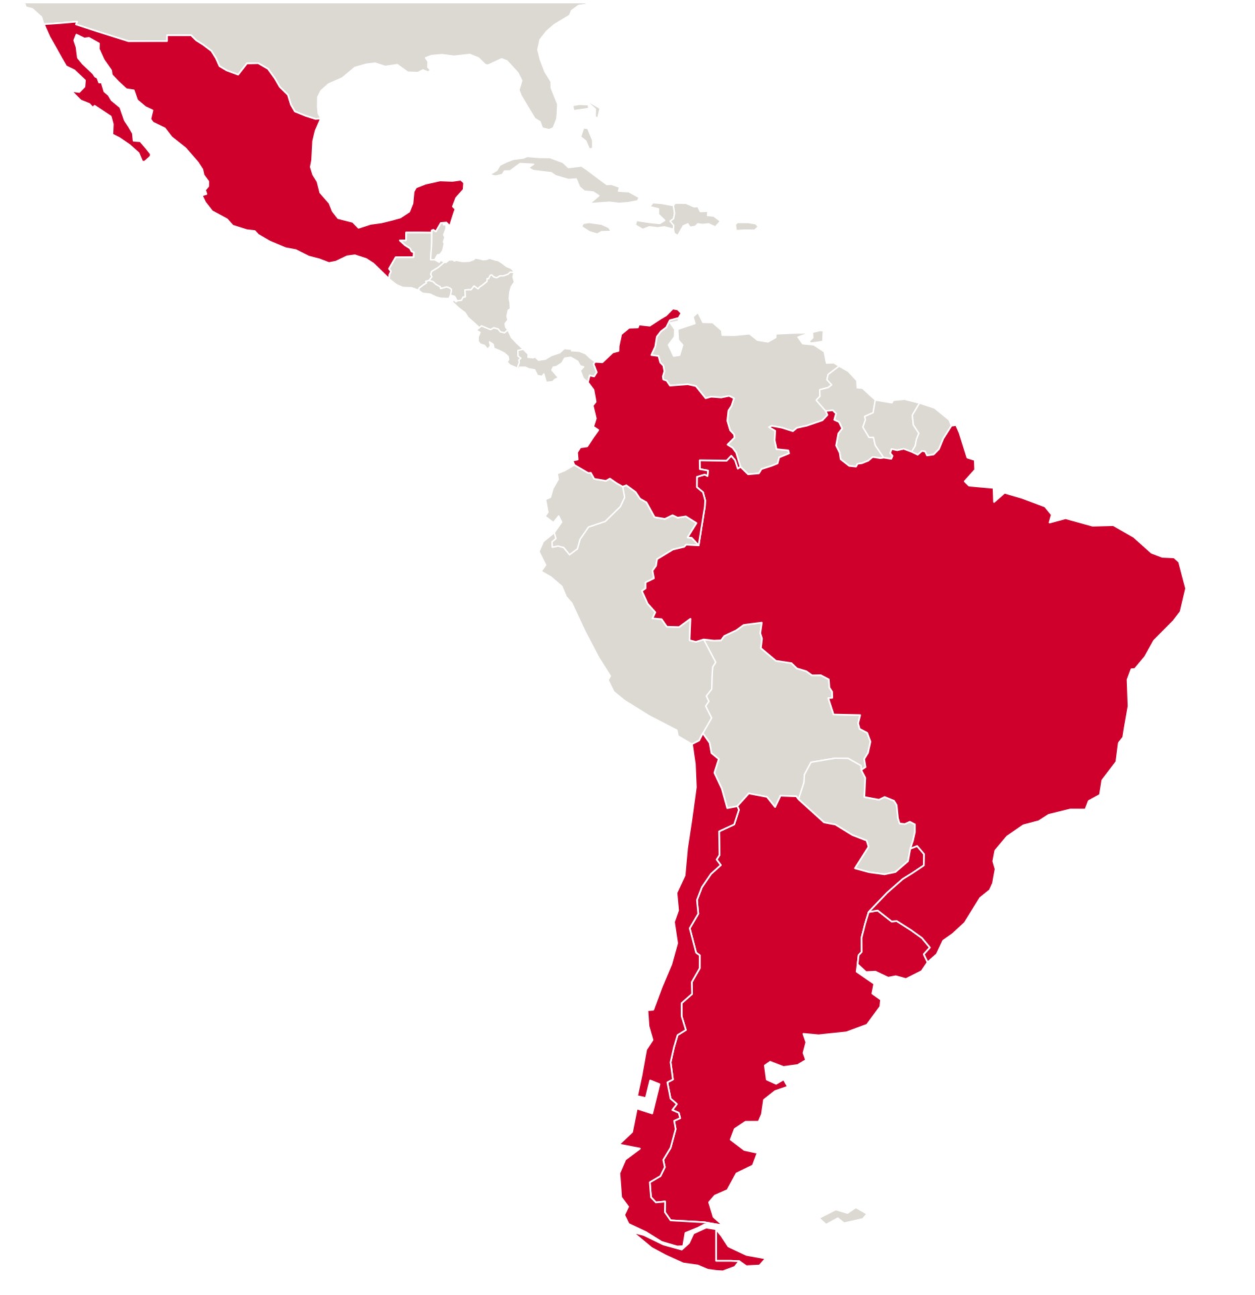
SCOPE
The six countries we compare
Argentina Brazil Chile
Colombia Mexico Uruguay
All groups compare the same six, so the rankings can be read against each other.
We have no preferred country. That is exactly what we would like to learn.
Different answers between groups are welcome.
Notes:
Sagen, dass Mexiko bewusst dabei ist, obwohl es geografisch nicht Suedamerika ist.

Slide 7
WHAT MATTERS TO US IN A MARKET
What we would look at
Premium coffee segment
Tourism and hotels
Its size in hospitality and in retail
Visitor volume, origin, and international hotel groups
Purchasing power
Competitive landscape
Economic development, and who can pay a premium price
Which premium brands are there, at what price
Import and regulation
Coffee culture
Tariffs, certification, and what applies to EU goods
How coffee is drunk, and how much of it outside the home
Both groups measure the same things. How you operationalise and weight them is yours to decide.
Add criteria you consider relevant, and justify your weighting and your choice of tool.
Notes:
Beim Punkt Import erwaehnen, dass wir aus Wien liefern. Deshalb zaehlen EU Ursprung und Zoelle.

Slide 8
WHO WE SELL TO
The customers a plan should aim at
Hospitality
Retail
Hotels with breakfast and bar service, especially with international guests
Premium restaurants and cafés
Venues where coffee is part of a quality experience
Grocery and delicatessen with a premium assortment
Shoppers who can pay a premium price
Where brands such as illy are already on the shelf
Less relevant
Venues and retailers competing on price, and areas without purchasing power.
Notes:
Hotels sind fuer uns die interessanteste Gruppe, weil dort Fruehstueck und Bar dazukommen.

Slide 9
THE HARD QUESTION
Why would a country that grows its own coffee buy coffee from Vienna.
Several of these countries roast their own coffee.
Your positioning has to answer this, and say who exactly would buy.
Notes:
Ehrlich sagen, dass wir darauf selbst noch keine gute Antwort haben.

Slide 10
OUR ANSWER SO FAR
And why it needs testing
We sell coffee house culture
The assumption is that this connects where a European influenced coffee culture already exists, and where hotels serve many European guests. It is unverified.
Two things that help you test it
Where European premium brands already sit, at what price, and whether venues advertise European origin.
Through our North American subsidiary we are already served in some international chains. Where they also operate here, they may be an easier first door.
Notes:
Klarstellen, dass wir kein Wunschergebnis haben. Eine Widerlegung ist fuer uns wertvoll.

Slide 11
RESEARCH
Where the evidence can come from
Desk research
USDA coffee country reports, trade statistics, tourism statistics, industry reports.
Observing the market online
Menus and prices, shelf prices, reviews, competitors on social media, and which brands hotels serve.
Our own material
The corporate story, the sustainability report and the website.
Notes:
Das Online Beobachten ist der Teil, der uns am meisten bringt.

Slide 12
WORKING TOGETHER
Ground rules and what we contribute
Ground rules
Public data only. We provide no internal figures, and none are needed.
If you contact companies, do so as students, not on behalf of Julius Meinl.
Nothing here is decided. Your work is one input into an open question.
From our side
Feedback on your market selection once the rankings are in.
Bundled questions during the term are answered by Group Export.
We attend the final presentations.
A visit to the roastery and the Coffee Academy in Vienna is intended.
Notes:
Beim Roestereibesuch sagen, dass wir es vorhaben und den Termin noch intern klaeren.

Slide 13
Questions are welcome
Elifa Maskaeva, Group Export
elifa.maskaeva@meinl.group
Send questions in bundled form and we answer them for the whole course.
Notes:
Zum Schluss sagen, dass wir uns auf die Ergebnisse freuen.

